Slide 1
Identifying Important Indicators for Explaining the Human Development Index
By:
Shristi Dhakal
Canhong Zhang
Angele Abi Yaghi
Bomi Choi
November 26th, 2019

Slide 2
Project Introduction
Human Development Index (HDI)
  Definition
A statistical tool used to measure a country’s overall achievement in its social and economic dimensions (“The Economic Times,” .n.d.).
  Indicators
Ayesha, n.d.:
Supplementary important indicators are necessary
Three main indicators
Longevity
Education or knowledge
Standard of living
Jahan, n.d.:
Notes:
what are other important indicators? It flows to the goal page.

Slide 3
Project Introduction
Objective:
Find out which additional variables are important in explaining the HDI
Usefulness:
Help non profit organizations to fund and support the most important causes
Aid undeveloped countries to improve their human development index
Tools used for data analysis:
Cluster Analysis
Linear Regression
Regression Tree

Slide 4
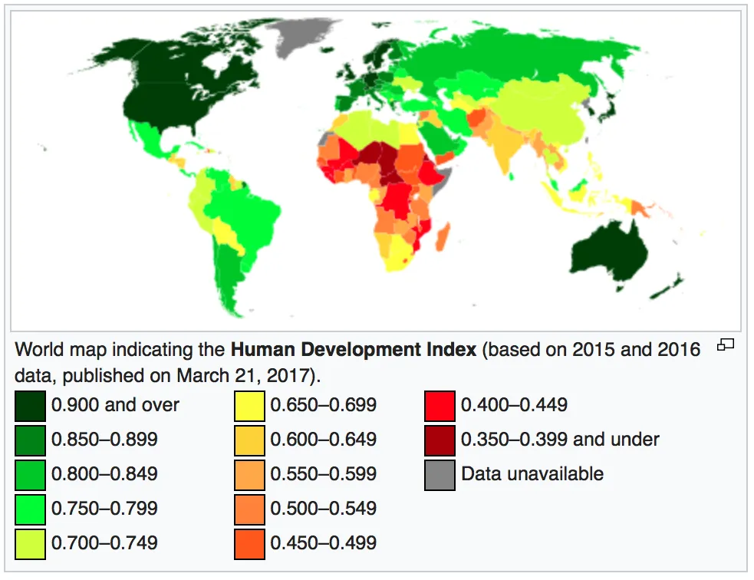
Data Sampling
Data Source: WordBank Database
Data composition
168 Countries
5 years → 2013-2017
840 observations
27 variables were included
Manual Data Selection:
Unrelated data
Drop Redundant regional data
Countries with unavailable HDI
Notes:
48 variables in the proposal.

Slide 5
Variables
Variable | Type
ID: Country/Year | Identifier
Access to electricity (% of population) | Numeric
Access to clean fuels and technologies for cooking (% of population) | Numeric
Age dependency ratio, young (% of working-age population) | Numeric
Population growth (annual %) | Numeric
Current health expenditure (% of GDP) | Numeric
Death rate, crude (per 1,000 people) | Numeric
Employers, total (% of total employment) | Numeric
Employers, female (% of female employment) | Numeric
Urban population (% of total population) | Numeric
Trade (% of GDP) | Numeric
Time required to start a business (days) | Numeric
Sex ratio at birth (male births per female births) | Numeric
Variable | Type
Individuals using the Internet (% of population) | Numeric
Inflation, consumer prices (annual %) | Numeric
School enrollment, primary (% gross) | Numeric
Oil rents (% of GDP) | Numeric
Number of under-five deaths | Numeric
Number of infant deaths | Numeric
GNI per capita growth (annual %) | Numeric
GNI per capita PPP (current international $) | Numeric
GDP per capita growth (Annual %) | Numeric
GDP per capita PPP (current international $) | Numeric
Strength of legal rights index (Weak, Medium or Strong) | Nominal
Life expectancy at birth, total (years) | Numeric
Military expenditure (% GDP) | Numeric
Mobile cellular subscriptions (per 100 people) | Numeric
Human Development Index (HDI) | Numeric
Notes:
Variable rules and levels: (27 variables)
HDI: Target and interval
26 Variables: Independent and numeric
1 variable: Independent and nominal
HDI-target and interval, 26-Independent and numeric, 1-independent and nominal

Slide 6
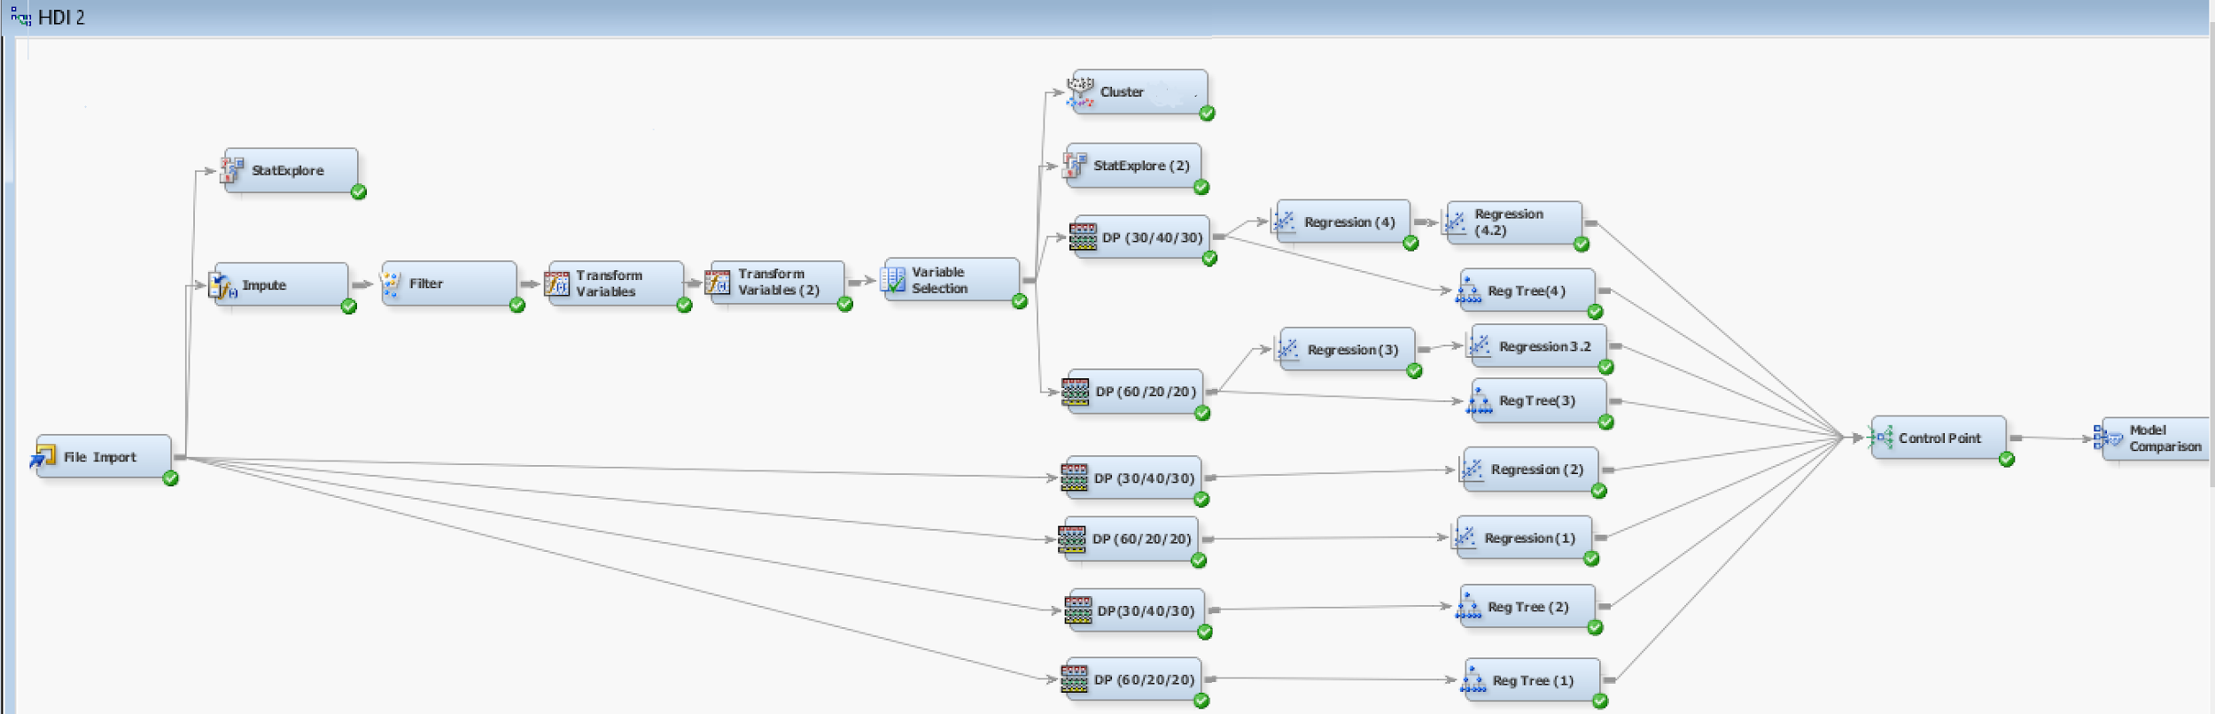
Complete Project Analysis Mapping

Slide 7
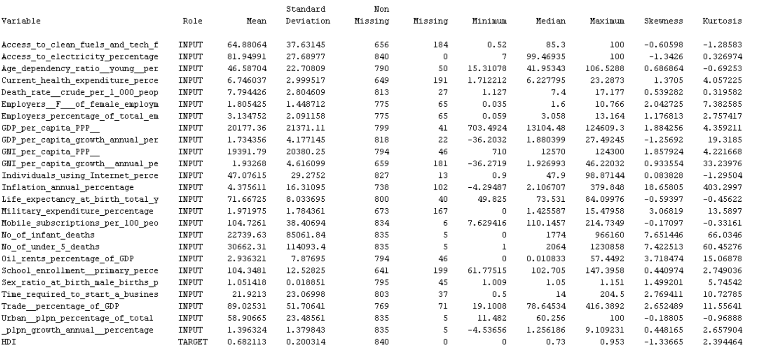
Data Explore
Some are Large
7.58% of the data
Some are high
Notes:
7.58% of the data (1,655 values /a total of 21,840 values)

Slide 8
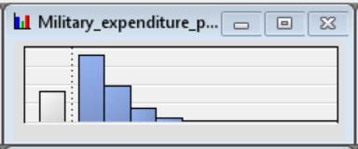


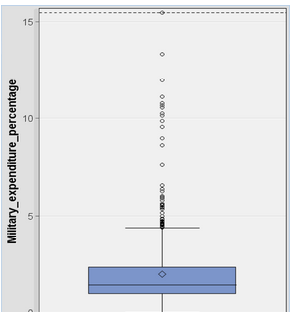
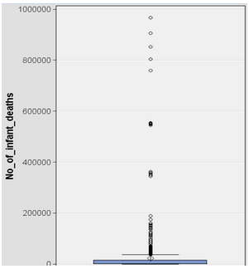
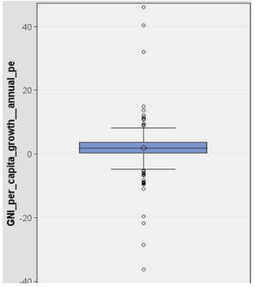
Examples of Skewness and Outliers
Military Expenditure
Skewness = 3.07
Number of Infant Deaths
Skewness = 7.65
Inflation (Annual %)
Skewness = 18.66
Notes:
At least there were detected 12 variables with outliers and 4 with high skewness
Variables that have Outliers: > 12 variables. High skewness → Inflation (annual %) (Skewness = 18.66)
Medium skewness → Number of infant deaths and Number of under 5 deaths (skewness=7.65 and 7.42)
Slight skewness → Oil rents (% of GDP) (skewness=3.72)

Slide 9
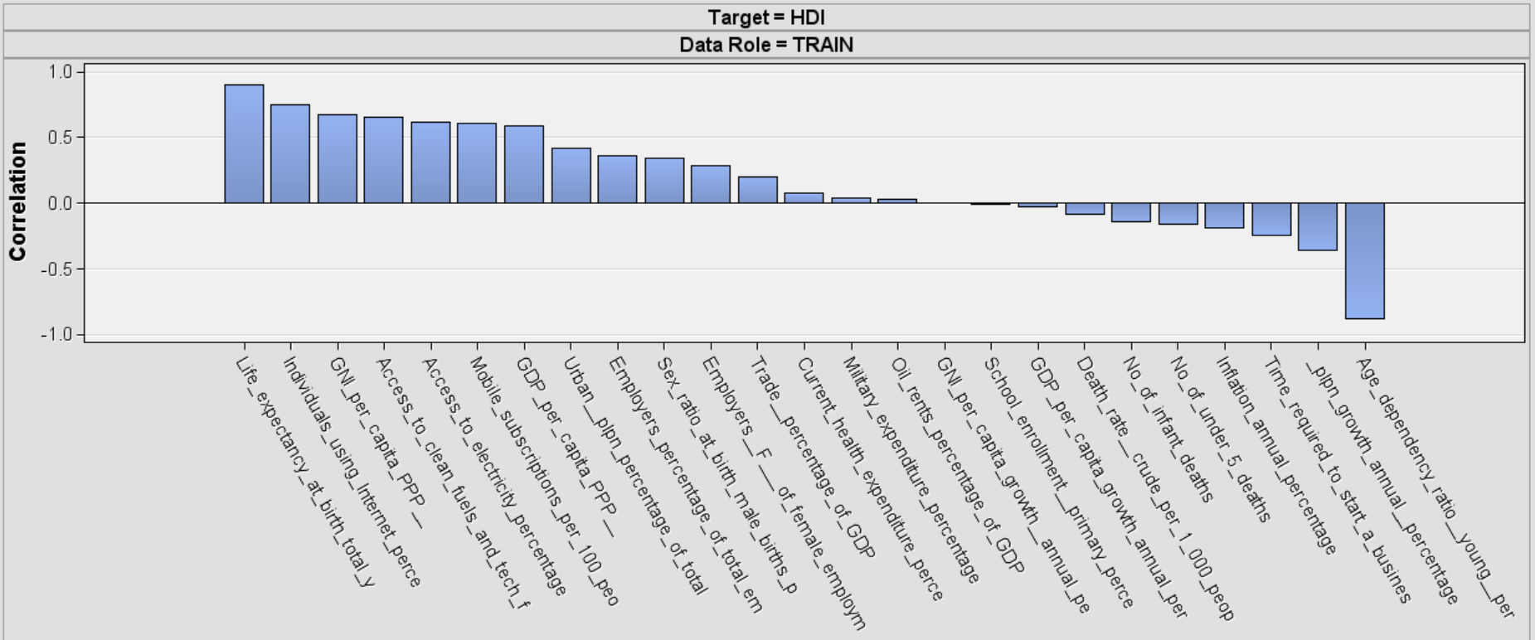
Correlation
Can we conclude anything from just this correlation graph?
Notes:
Life Expectancy, Age dependency ratio(negative), GNI per capita PPP, Individual using internet, Access to clean electricity.

Slide 10
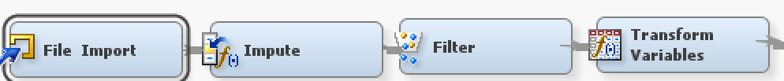
Data Preprocessing
Data Cleaning
Missing data → Interval & class variables: Tree Surrogate;
Missing cutoff: 100%;
Other settings: default
Noisy data → Exclude 186 observations by Filter node
Skewness → Transformation using Log 10 for the skewness.
High skewness → Inflation (annual %) (Skewness = 18.66)
Medium skewness → Number of infant deaths and Number of under 5 deaths (skewness=7.65 and 7.42)
Slight skewness → Oil rents (% of GDP) (skewness=3.72)
Stabilizing variance → Transformed variables by standardization (Excluded nominal variables in this step)
Standard deviation is large in these variables:
GDP per capita PPP
GNI per capita PPP
Number of under 5 deaths
Number of infant deaths
Notes:
Variable rules and levels: (27 variables)
HDI: Target and interval
26 Variables: Independent and numeric
1 variable: Independent and nominal
HDI-target and interval, 26-Independent and numeric, 1-independent and nominal
After handling missing data and noisy data, we find the variables in the dataset have values in different ranges and skewed. variable transformations can be used to stabilize variance, remove nonlinearity, improve additivity, and counter non-normality. Standardization is the process of transforming a variable to one with a mean of 0 and a standard deviation of 1. to put variables on the same scale if they were on very different scales unstandardized, we do standardization.
Data explore:
Missing data: 7.58% of the data (1,655 values of 21,840 total values).
Skewness:
‘’Inflation_annual_percentage’’ is highly skewed (Skewness = 18.66),
followed by the variables ‘’Number_of_infant_deaths’’ and ‘’Number_of_under_5_deaths’’. The variable ‘’Oil rents percentage of GDP’’ is slightly skewed
Outliers: at least 12 variables. found by histogram and box plots
Standard deviations are also very large in these variables:
‘’GDP per capita PPP’’, ‘’GNI per capita PPP’’, ‘’Number of under 5 deaths’’ and ‘’Number of infant deaths’’.
Relationship of variables
Variables that have Outliers: > 12 variables.
Presented by histograms and box plots,

Slide 11
Data Preprocessing
2. Data Integration and Reduction
Variable Selection
Manual selection → Unrelated observations were manually rejected before importing the data into the
software.
Variable selection node
  Redundancy → Rejected Number of infant deaths → Information overlap with Number of under 5 deaths
  To keep variables that have more influence
  Default settings: Minimum R square of 0.005 and a minimum Chi square of 3.84
Notes:
3. Methods used to deal with data issues
Missing values:
Impute node . Tree Surrgate for 2 types of variables and setting missing cutoff 100%. other settings: default.
Outliers: filter node
Skewness: Transform node and log 10 for ‘’Inflation_annual_percentage’’ is highly skewed (Skewness = 18.66), followed by the variables ‘’Number_of_infant_deaths’’ and ‘’Number_of_under_5_deaths’’. The variable ‘’Oil rents percentage of GDP’’
Stabilizing variance transform variable by standardization.(exclude nominal in this step)
Redundancy:
variable selection--Minimum R square of 0.005 and a minimum Chi square of 3.84, and reject no of infant death in editing variables.

Slide 12
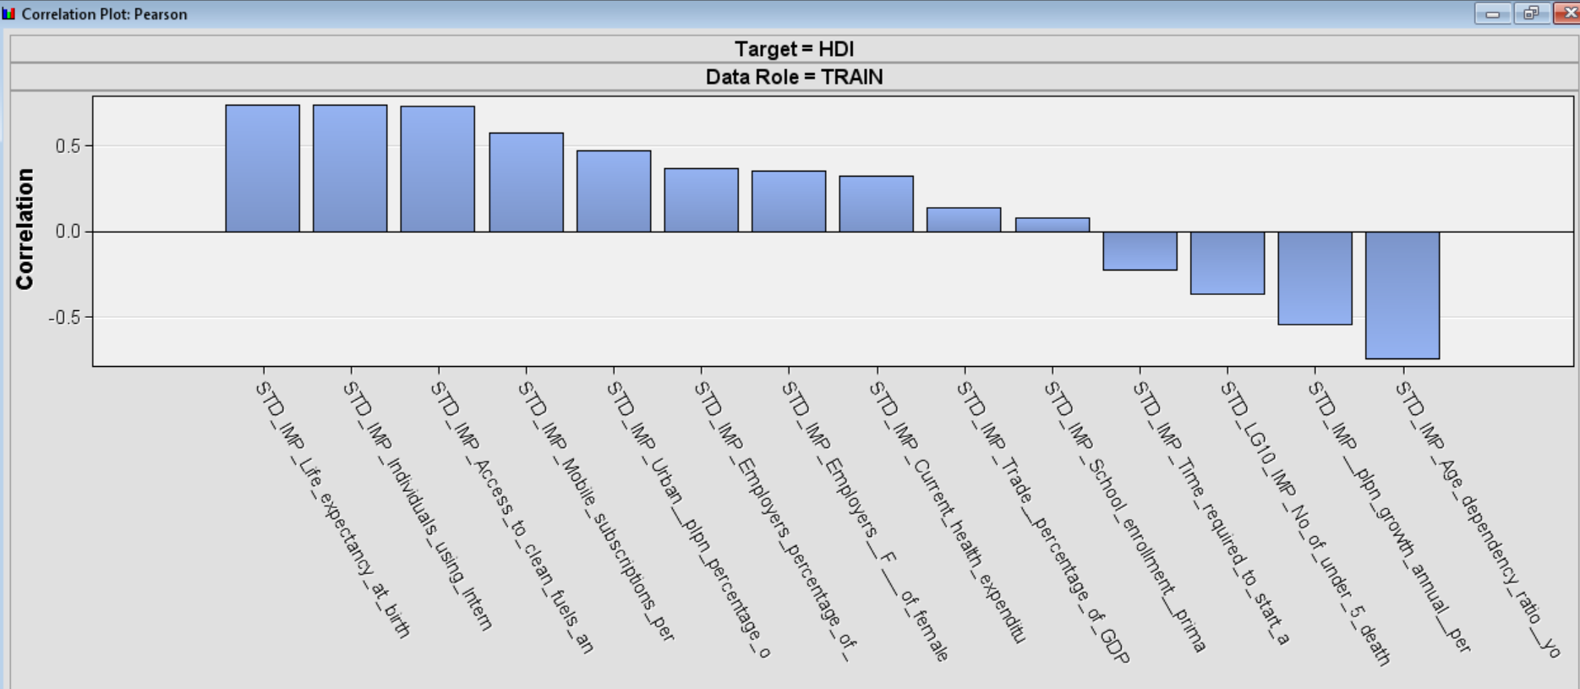
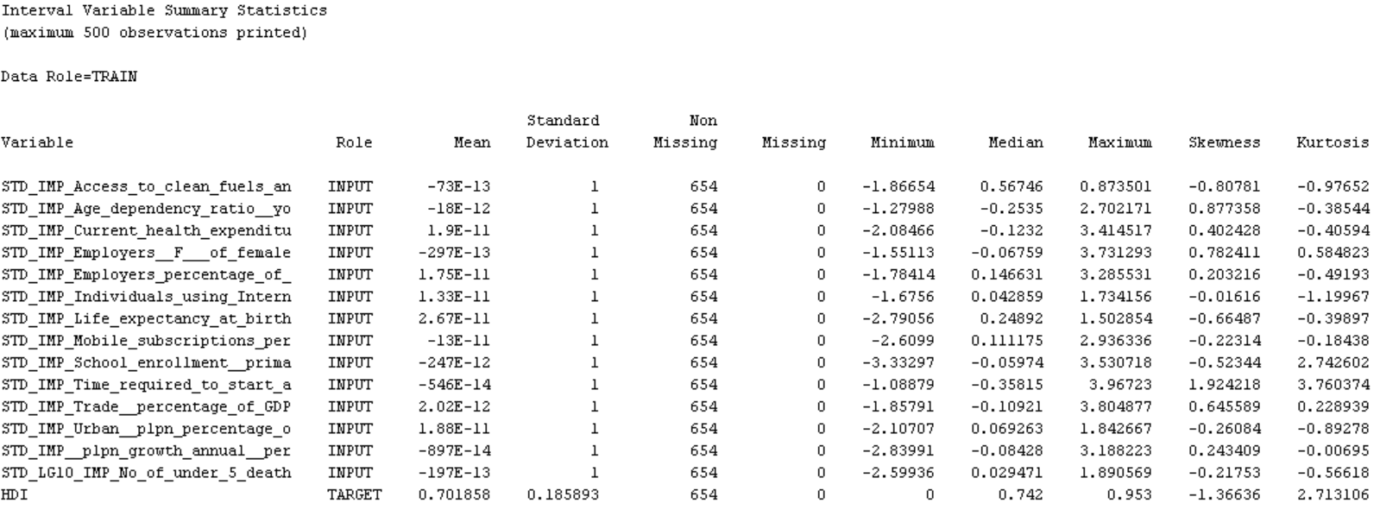
Data Exploration after Data Preprocessing
Normal skewness
Normal standard deviation
No missing values
No outliers
Relationship of the variables with the target variable HDI
Notes:
life expectancy at birth, individuals using internet, access to clean fuels and technology, age dependency ratio, population growth.

Slide 13
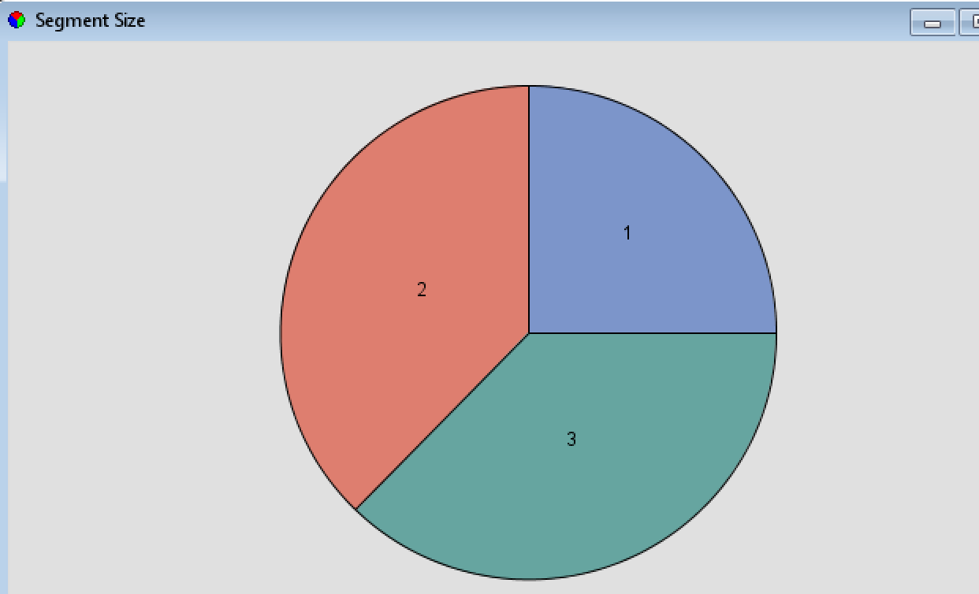
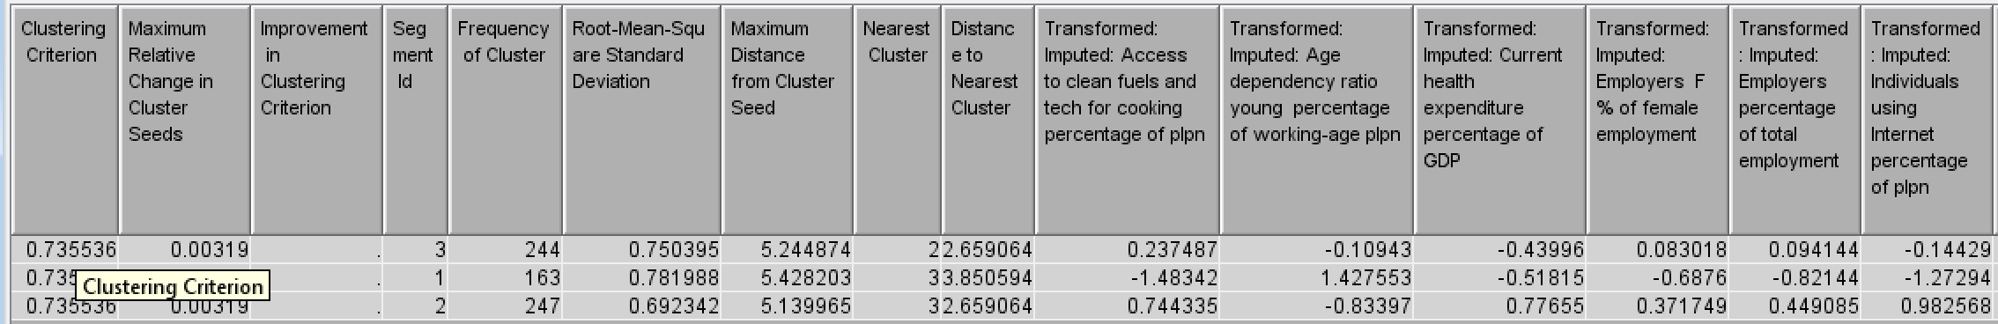
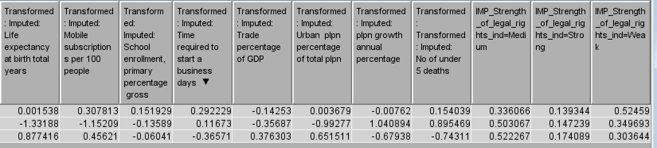
Cluster Analysis
Goal: Identify interesting patterns
Settings:
3 clusters were specified
Variables were standardized
Segment 1 → Underdeveloped countries
Segment 2 → Developed countries
Segment 3 → Developing countries
Notes:
Unsupervised partitioning, Tried multiple K number.Distance between Segment 3 and Segment 2 is closer than their distance to Segment 1. Segment 2 has the characteristics of developed countries that show a higher mean value on access to clean fuels and technology for cooking, health expenditure percentage of GDP, the percentage of women's employment, the percentage of individuals using the internet, life expectancy at birth, mobile subscriptions per 100 people, the percentage of urban population, and have shorter time required to start a business, lower dependency on young working-age population, a lower number of under-five deaths, and lower population growth rate.

Slide 14
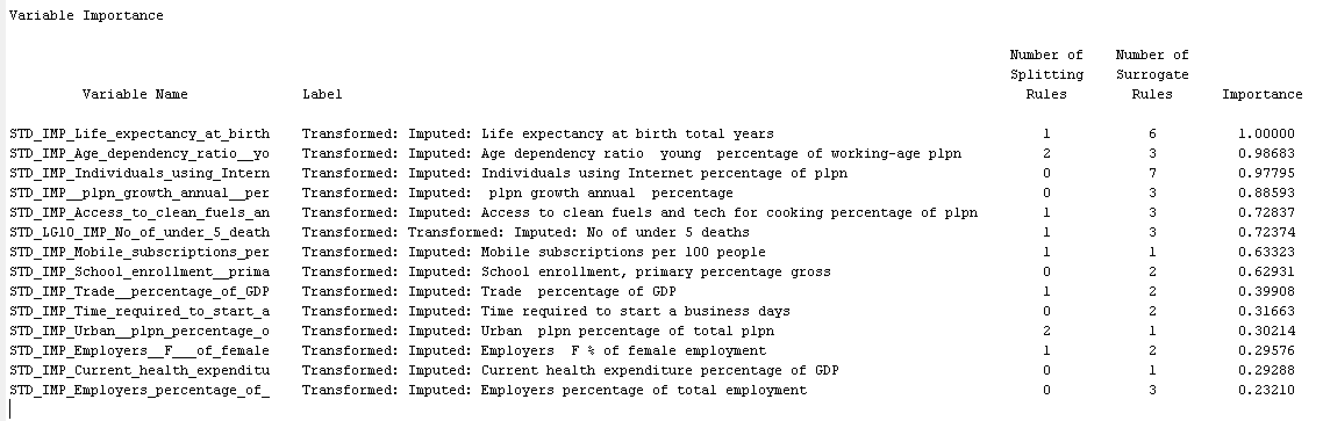
Cluster Analysis (continued)
Notes:
14 interval variables are used for generating segments. The results show that the five most important variables are: “Life expectancy at birth, total (years)”, “Age dependency ratio, young (% of working-age population)”, “Individuals using the Internet (% of population)”, “Population growth (annual %)”, and “Access to clean fuels and technologies for cooking (% of population)”.

Slide 15
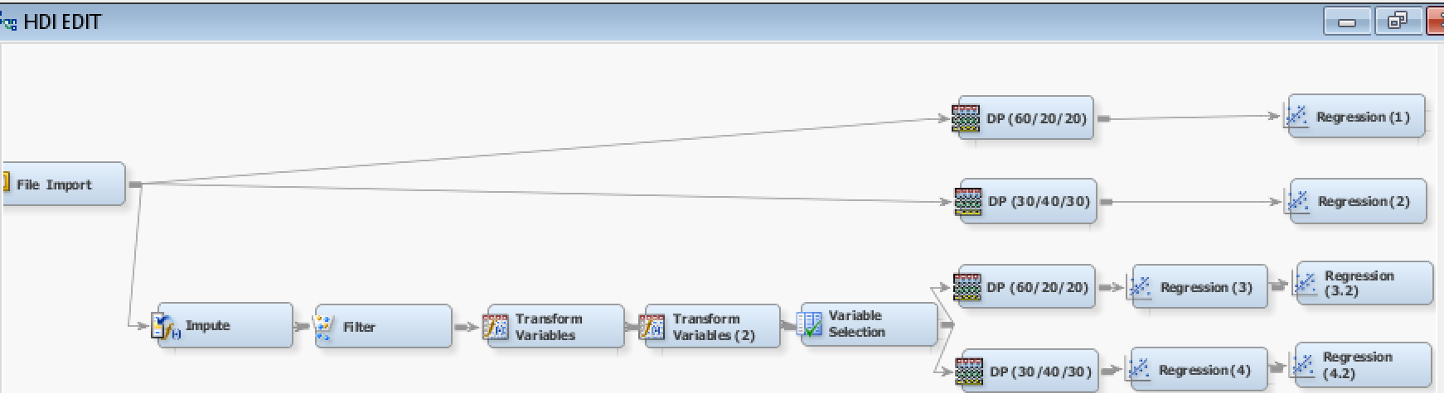
Data Partition
Linear Regression Models:
60/20/20 → Linear Regression 1 and 3 & Regression Tree 1 and 3
30/40/30 → Linear Regression 2 and 4 & Regression Tree 2 and 4
Partitioning Method: Simple Random
Settings: Linear, Stepwise, Validation Error
Notes:
explain why do we connect 3.2 and 4.2 behind regression 3 and regression 4
Regression Type: Linear Regression
Selection Model: Stepwise
Selection Criterion: Validation Error

Slide 16
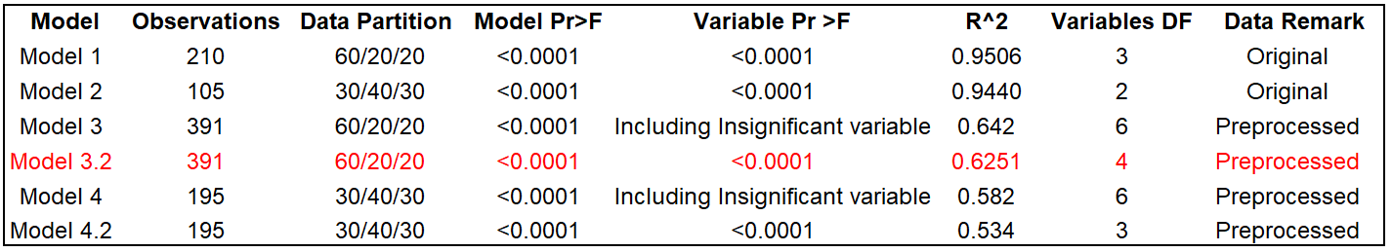
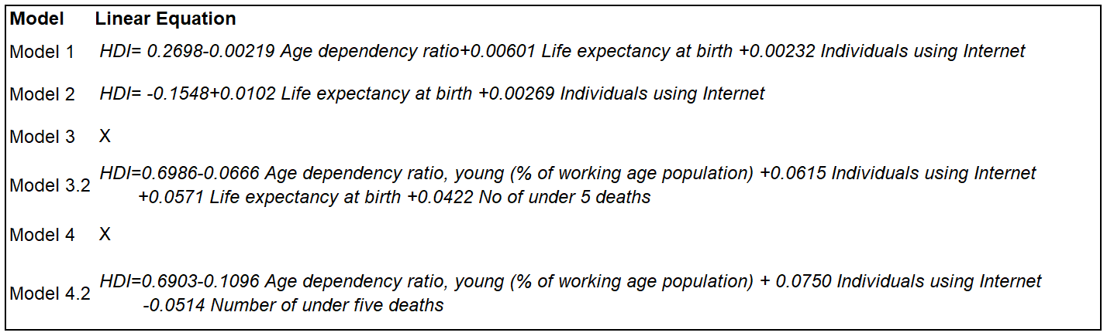
Results: Linear Regression Models

Slide 17
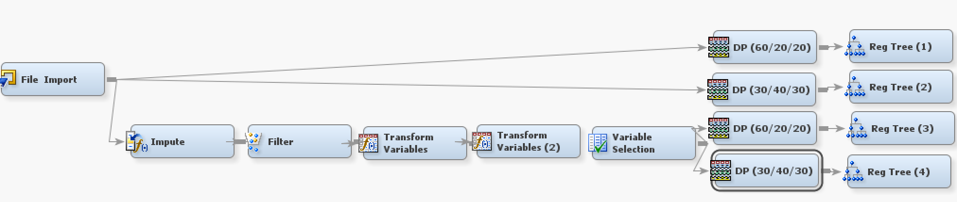
Regression Tree Models Analysis:
Setting: a significance level of 0.2, Assessment Measure: Average Square Error

Slide 18
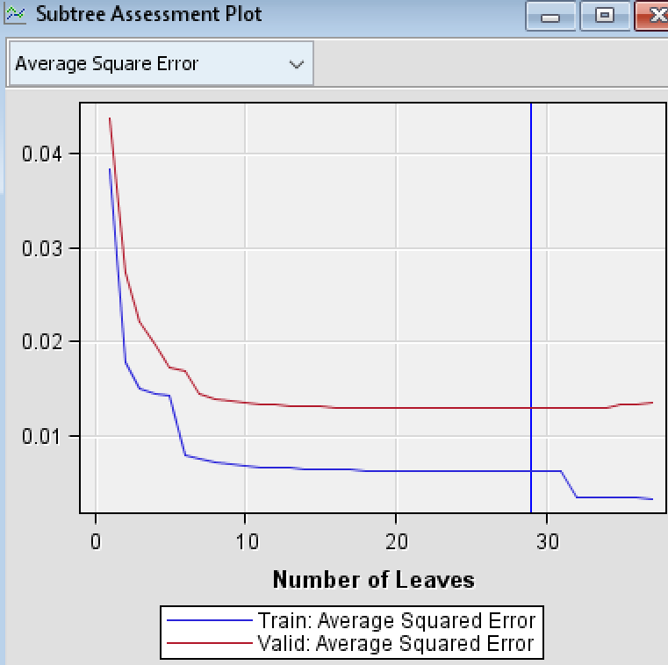
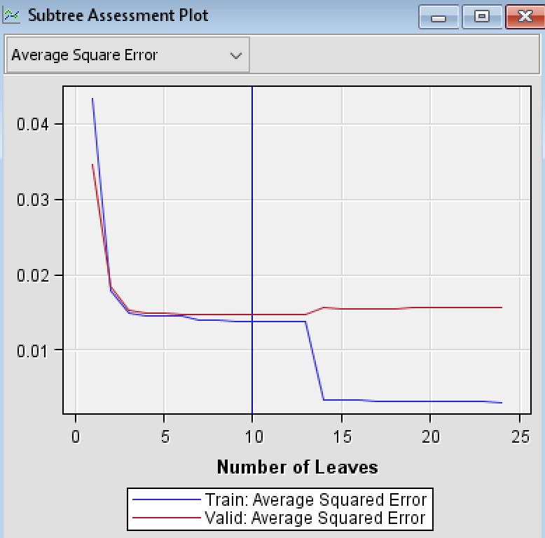
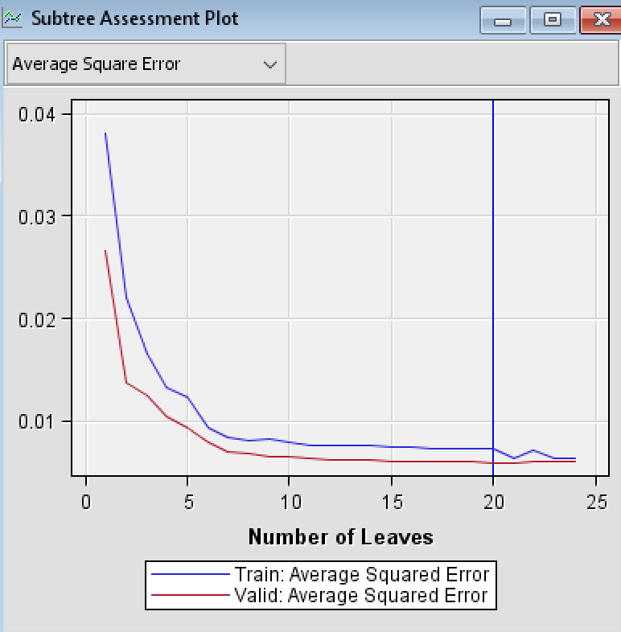
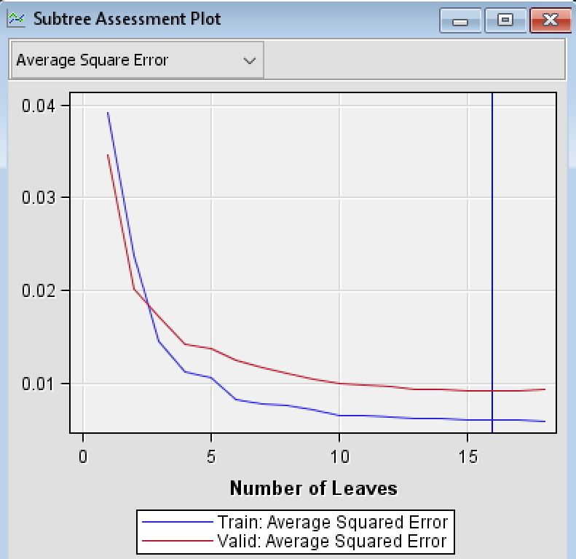
Subtree Assessment Plot: Regression Trees
Model | Number of leaves | Number of important variables
Regression Tree 1 | 29 | 16
Regression Tree 2 | 10 | 5
Regression Tree 3 | 20 | 7
Regression Tree 4 | 16 | 8

Slide 19
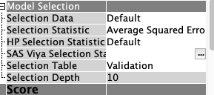
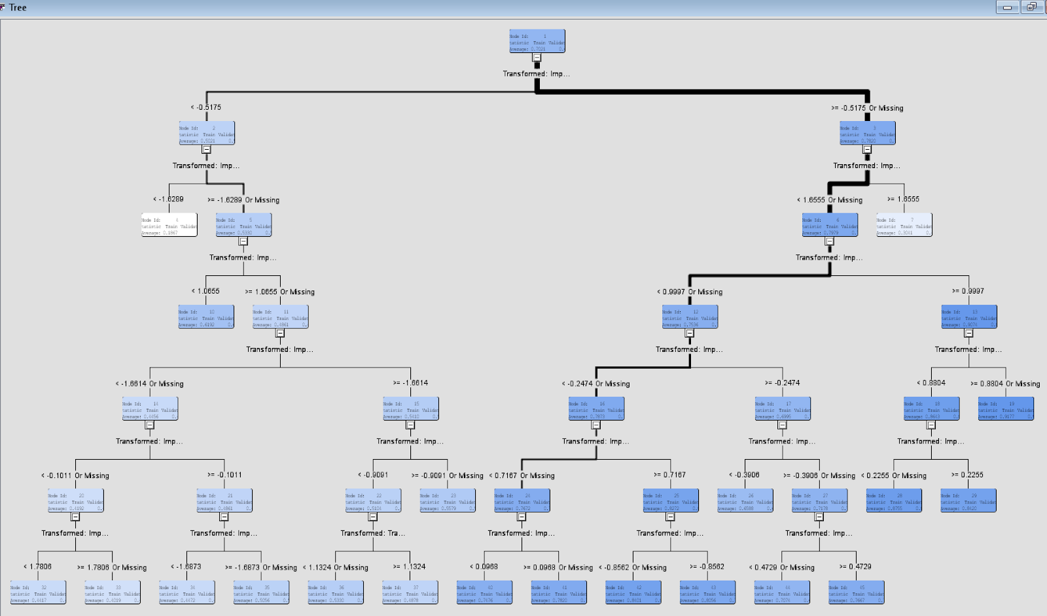
Model Comparison & Selection
Selected model: Regression Tree 3 Selection Criteria
Model | Validation: Average Squared Error | Number of significant variables
Regression Tree 3 | 0.00604 | 7
Linear Regression 3.2 | 0.00769 | 4
Linear Regression 3 | 0.00792 | Insignificant
Regression Tree 4 | 0.00924 | 8
Linear Regression 4.2 | 0.01149 | 3
Linear Regression 4 | 0.01219 | Insignificant
Linear Regression 2 | 0.01264 | 2
Regression Tree 1 | 0.01290 | 16
Regression Tree 2 | 0.01464 | 5
Linear Regression 1 | 0.01629 | 3
Notes:
To do: Post a screenshot of model comparison results.

Slide 20
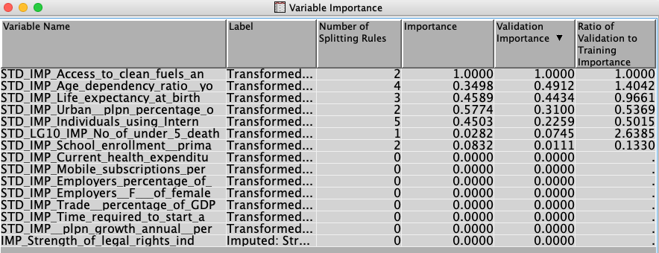
Regression Tree Model 3
Notes:
The results of the regression tree 3 shows that the optimal tree has 20 leaves using Access to clean fuels and tech for cooking (% of population) as the first split and majority of the branches falling towards Access to clean fuels and tech for cooking (% of population) higher than or equal to -0.5175. Based on the tree and the variable importance statistics below, 7 variables are important. The five most important variables were: ‘’Access to clean fuels and tech for cooking (% of population)’’, ‘’Age dependency ratio (young percentage of working-age population)’’, ‘’Life expectancy at birth (total years)’’, ‘’Urban population (% of total population)’’, and ‘’Individuals using Internet (% of population)’’, with each of their variable importance being 1.0, 0.49, 0.44, 0.31, and 0.23 respectively.
The subtree assessment plot below shows that the training data and the validation data perform in a similar trend, the error decreases as the number of leaves increases and it stays very minimal after leaf 20.

Slide 21
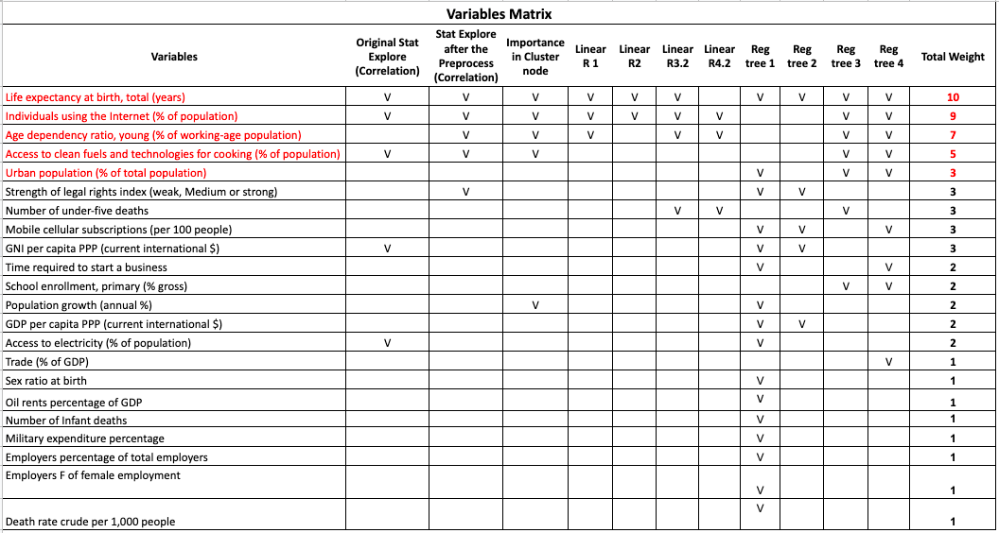
Variable matrix

Slide 22
Managerial Implications
Limitations
Helping non-profit organizations in finding the most important causes
Reducing risk
Assisting awareness programs
Comparison of countries
Attract donors with real data and insights visualization
Other variables importance
Time
Data Availability and Inclusion

Slide 23
Link and References
Link to the database:
https://docs.google.com/spreadsheets/d/1Q-8-uCacbW4DBhipwue8uR-qJKwCYQnior8xpy6oJRI/edit?usp=sharing
References in the document:
Ayesha (n.d). Human Development Index (HDI): Indicators & Shortcomings | Economics. Retrieved from: http://www.economicsdiscussion.net/economic-development/hdi/human-development-index-hdi-indicators-shortcomings-economics/29945
Jahan S. (n. d.) The Human Development Index – what it is and what it is not. Retrieved from The United Nations Development Programme: http://hdr.undp.org/en/hdi-what-it-is
The Economic Times. (n.d.). Retrieved from: https://economictimes.indiatimes.com/definition/human-development-index?from=mdr

Slide 24

Thank you!

